Slide 1
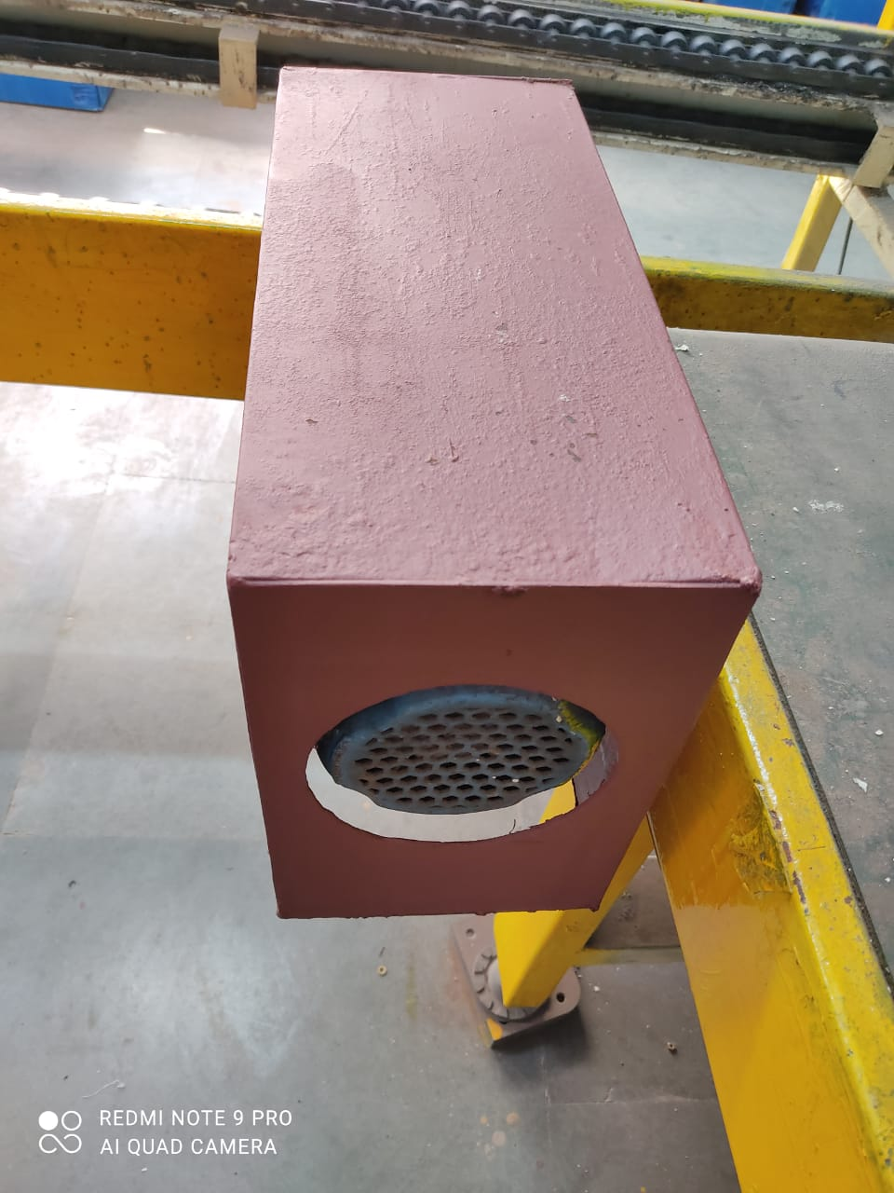
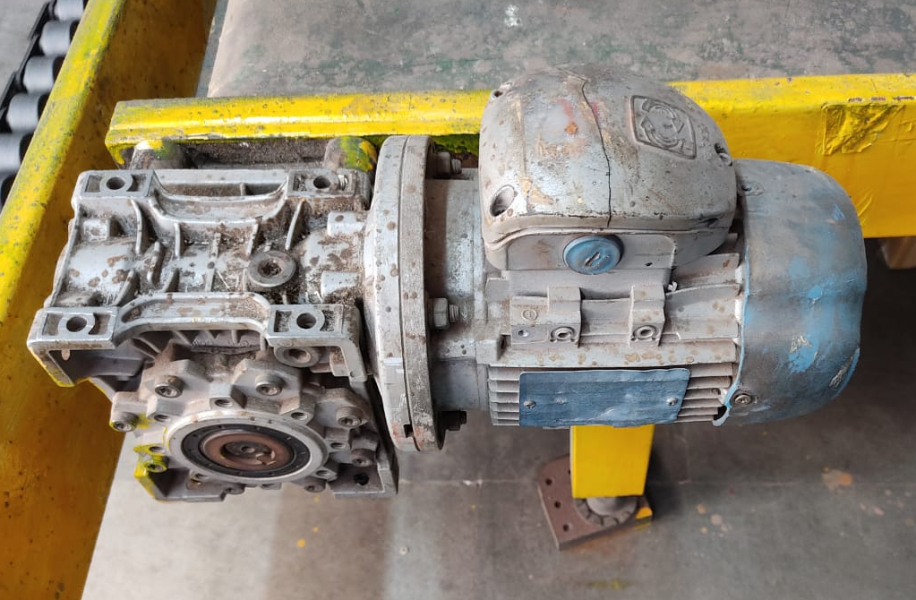
Kaizen
Dept./Section : Storage water heater
Process : Assembly line
Date of implementation : 10-06-2021
Improvement categories (Tick the applicable one’s) :
(1) Quality imp.
(2) Manpower/Man hours
(3) Reduce 3M
(4) Space saving
(5) Time saving
(6) Energy Saving
(7) Tact
(8) Yield
(9) 5S
(10) Efficiency
(11) Material Saving
(12) Waste Reduction
(13) Packing
(14) Safety
(15) Others
Before
After
Conveyor motor without cover.
Conveyor motor with cover.
Benefits:
1- Prevention of accidental contact with motor running parts
2- Prevention of motor from environmental dust

Slide 2
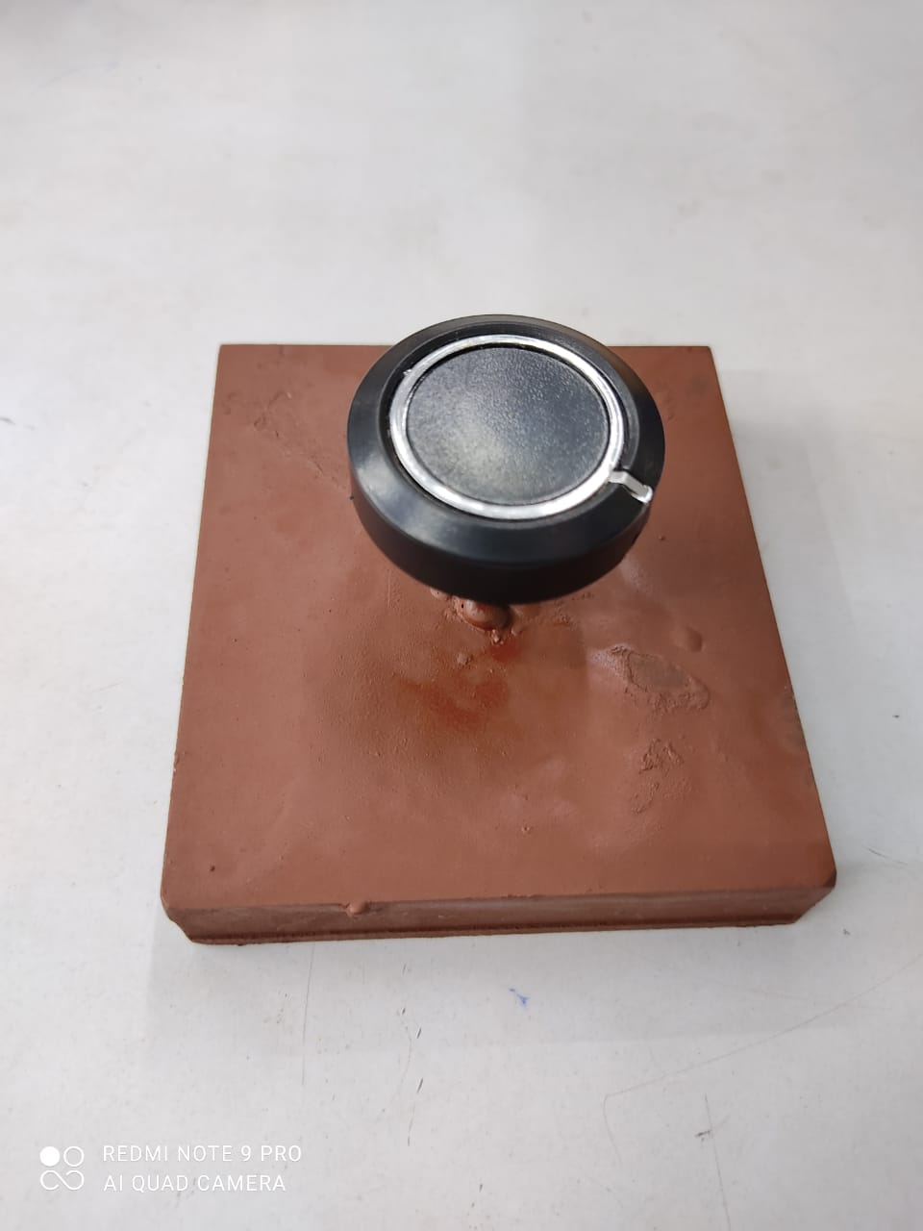
Kaizen
Dept./Section : Storage water heater
Process : IQC
Date of implementation : 05-06-2021
Improvement categories (Tick the applicable one’s) :
(1) Quality imp.
(2) Manpower/Man hours
(3) Reduce 3M
(4) Space saving
(5) Time saving
(6) Energy Saving
(7) Tact
(8) Yield
(9) 5S
(10) Efficiency
(11) Material Saving
(12) Waste Reduction
(13) Packing
(14) Safety
(15) Others
Before
After
No Preview Available
Knob checked manually.
AMICA Knob checked by JIG.
Benefits:
1- Time Saving

Slide 3
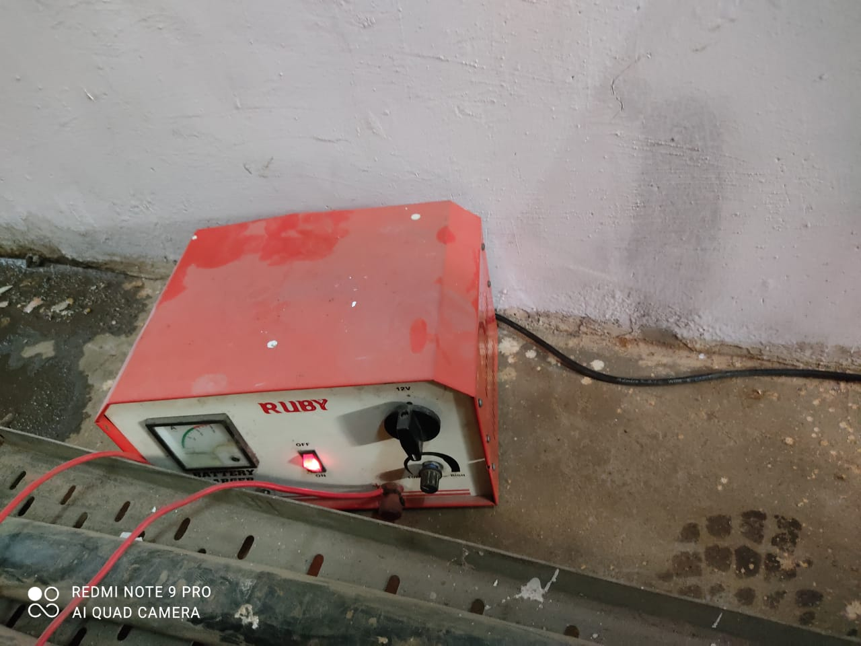
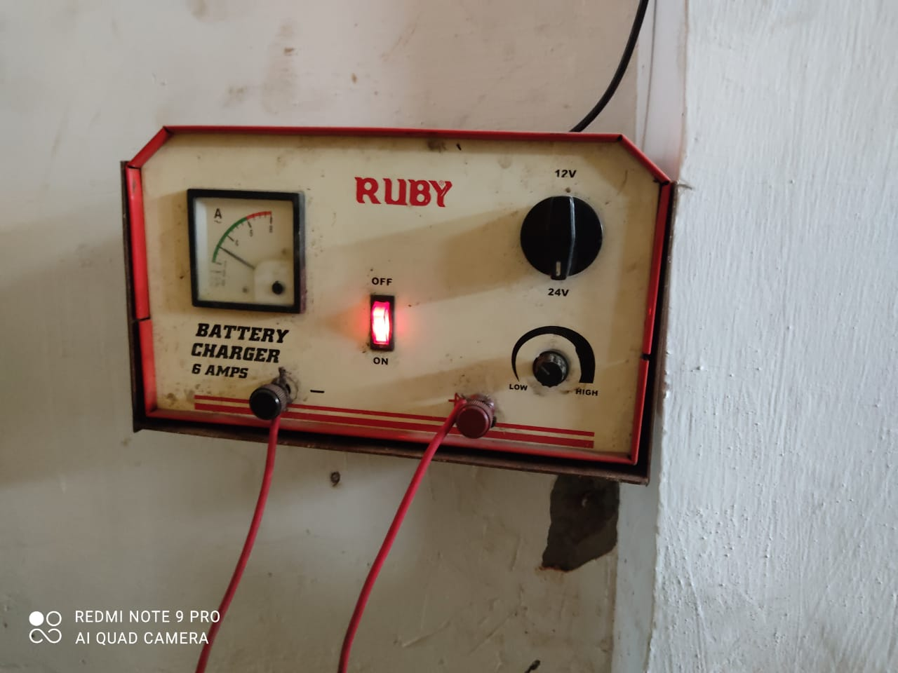
Kaizen
Dept./Section : Maintenance
Process : Maintenance
Date of implementation : 20-06-2021
Improvement categories (Tick the applicable one’s) :
(1) Quality imp.
(2) Manpower/Man hours
(3) Reduce 3M
(4) Space saving
(5) Time saving
(6) Energy Saving
(7) Tact
(8) Yield
(9) 5S
(10) Efficiency
(11) Material Saving
(12) Waste Reduction
(13) Packing
(14) Safety
(15) Others
Before
After
No defined location of machine
Instrument Arranged Properly.
Benefits:
1- Human Safety from accidental contact
2- Instrument prevention from dust.

Slide 4
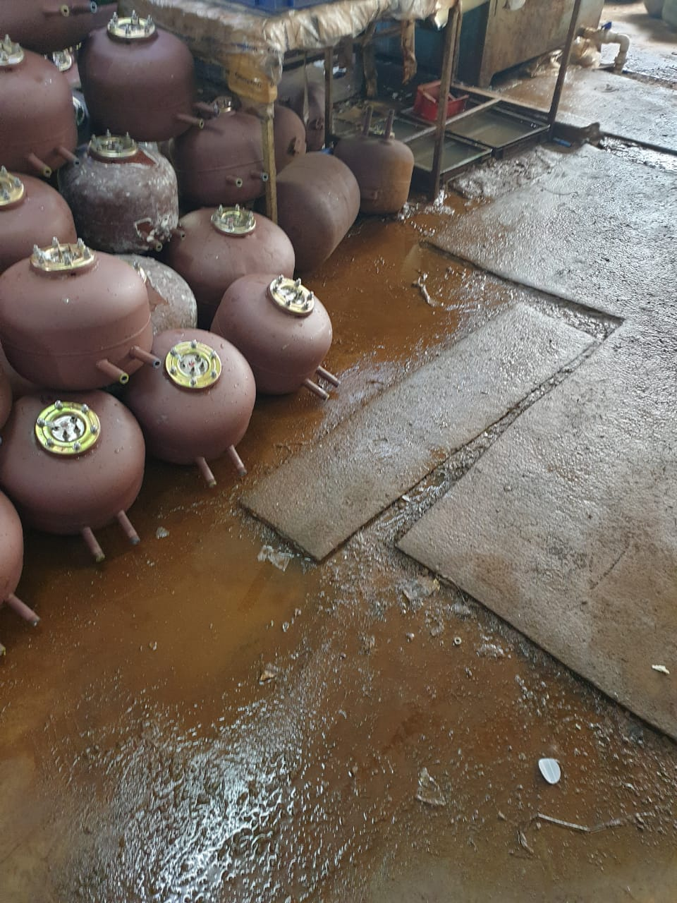
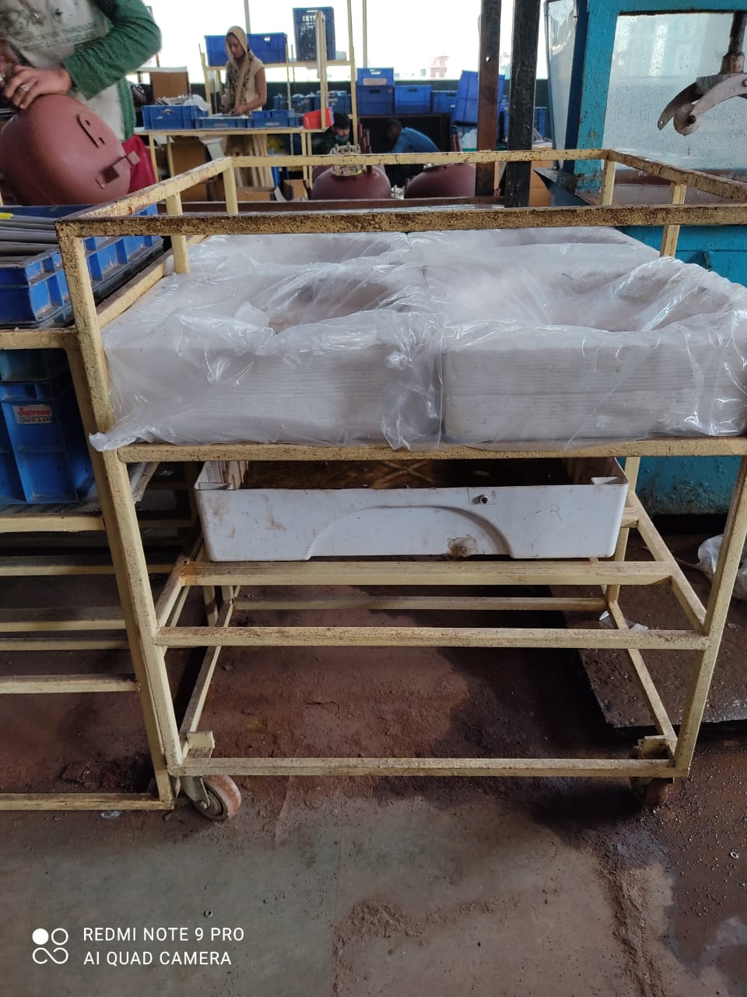
Kaizen
Dept./Section : Tank Leakage Testing
Process : Leakage Testing
Date of implementation : 15-06-2021
Improvement categories (Tick the applicable one’s) :
(1) Quality imp.
(2) Manpower/Man hours
(3) Reduce 3M
(4) Space saving
(5) Time saving
(6) Energy Saving
(7) Tact
(8) Yield
(9) 5S
(10) Efficiency
(11) Material Saving
(12) Waste Reduction
(13) Packing
(14) Safety
(15) Others
Before
After
Water splitting on floor after leakage testing
Table with sump to prevent water splitting
Benefits:
1- Prevention of water splitting on floor
2- Prevention of accident due to slippery surfaces
3- Improve 5S of floor

Slide 5
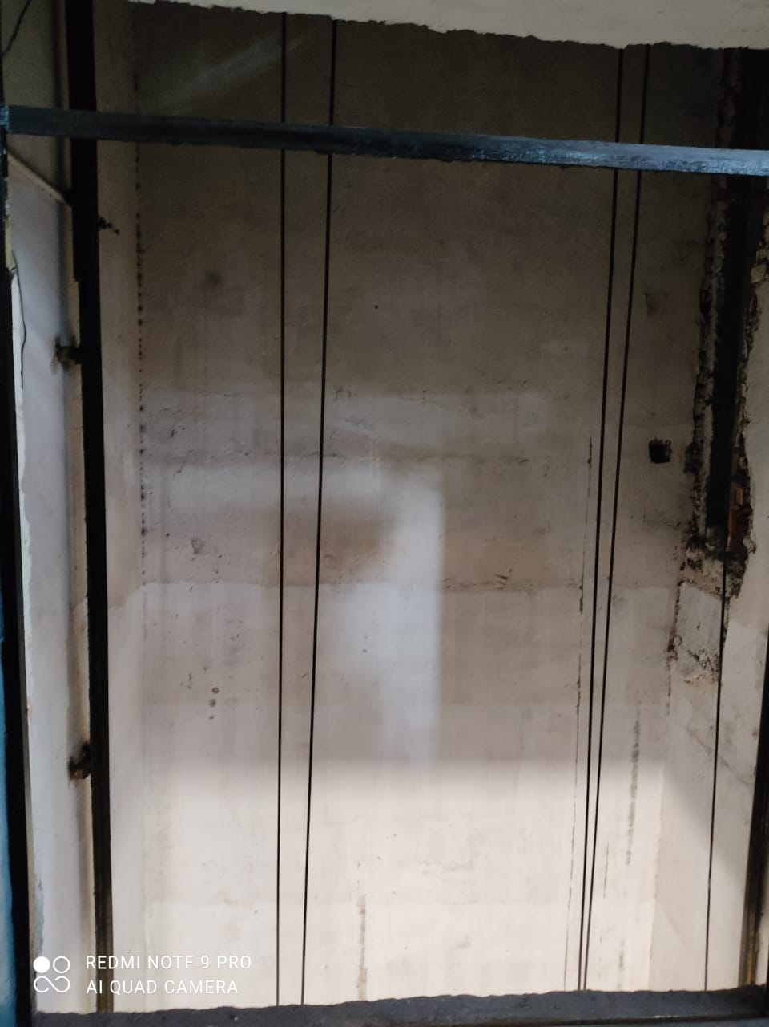
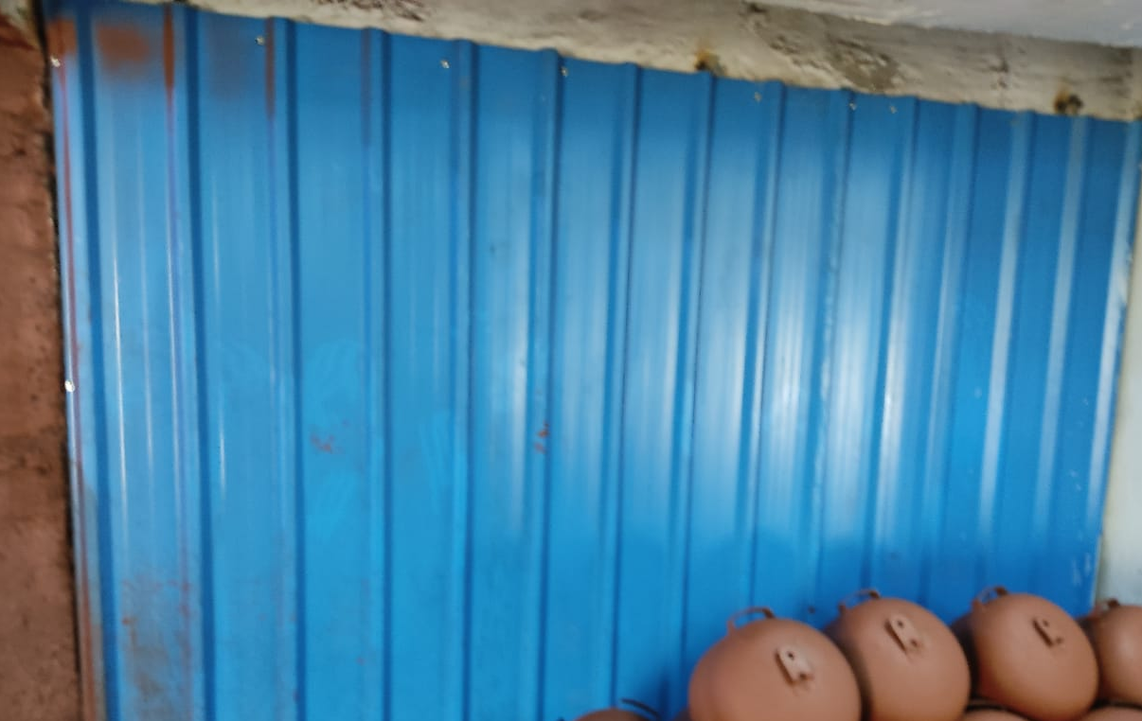
Kaizen
Dept./Section : Coating Section
Process : Primer Section
Date of implementation : 08-02-2021
Improvement categories (Tick the applicable one’s) :
(1) Quality imp.
(2) Manpower/Man hours
(3) Reduce 3M
(4) Space saving
(5) Time saving
(6) Energy Saving
(7) Tact
(8) Yield
(9) 5S
(10) Efficiency
(11) Material Saving
(12) Waste Reduction
(13) Packing
(14) Safety
(15) Others
Before
After
Lift door without any protection
Lift door covered with sheet
Benefits:
1- Human & material safety from accidents

Slide 6
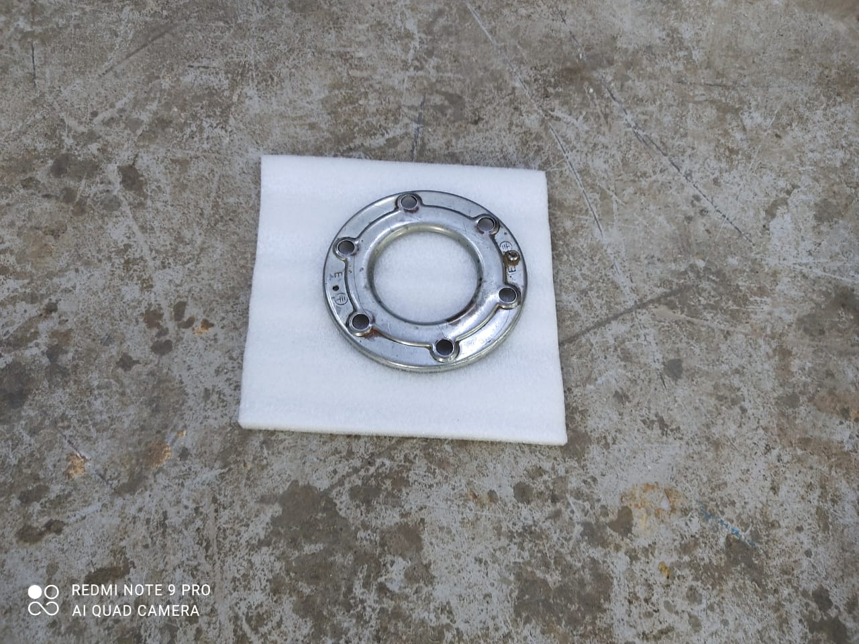
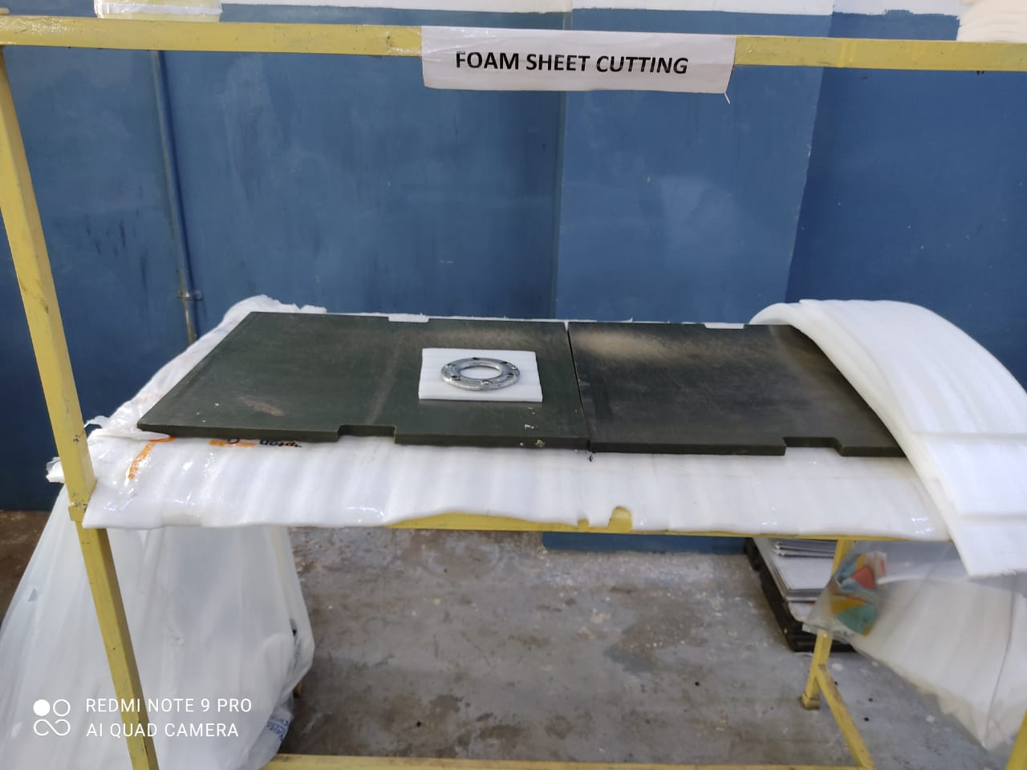
Kaizen
Dept./Section : Storage water heater
Process : Assembly Line
Date of implementation : 08-02-2021
Improvement categories (Tick the applicable one’s) :
(1) Quality imp.
(2) Manpower/Man hours
(3) Reduce 3M
(4) Space saving
(5) Time saving
(6) Energy Saving
(7) Tact
(8) Yield
(9) 5S
(10) Efficiency
(11) Material Saving
(12) Waste Reduction
(13) Packing
(14) Safety
(15) Others
Before
After
EPM Foam sheet cutting on floor
Proper work location with table
Benefits:
1- Floor 5S
2- Effective space utilization

Slide 7
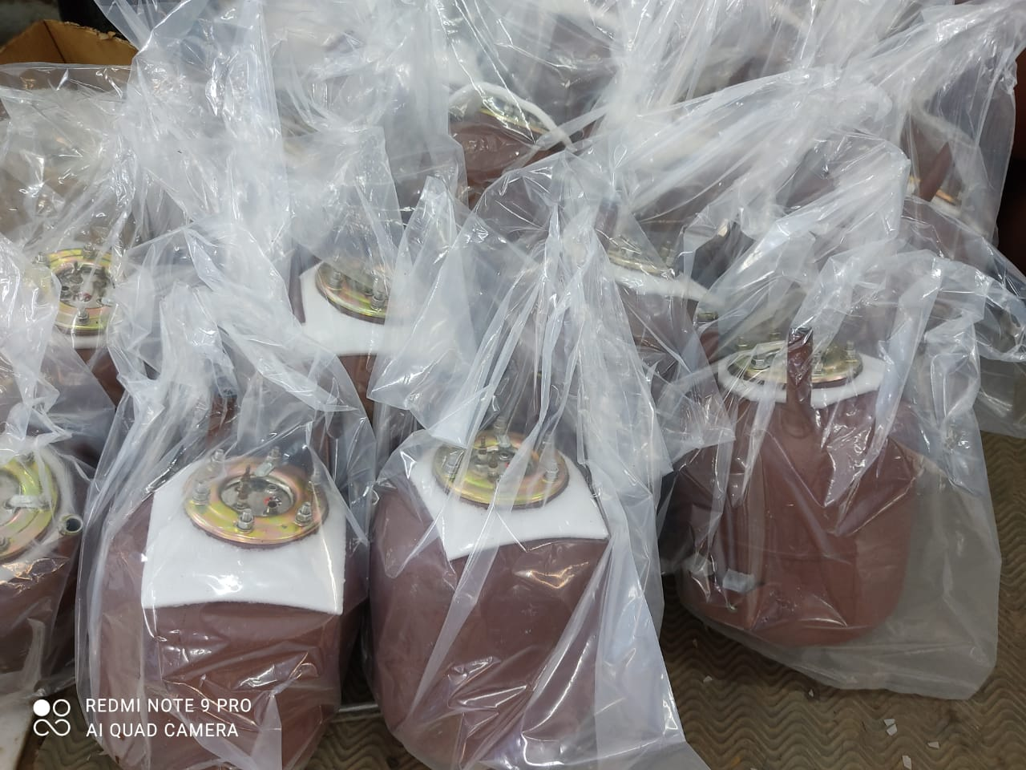
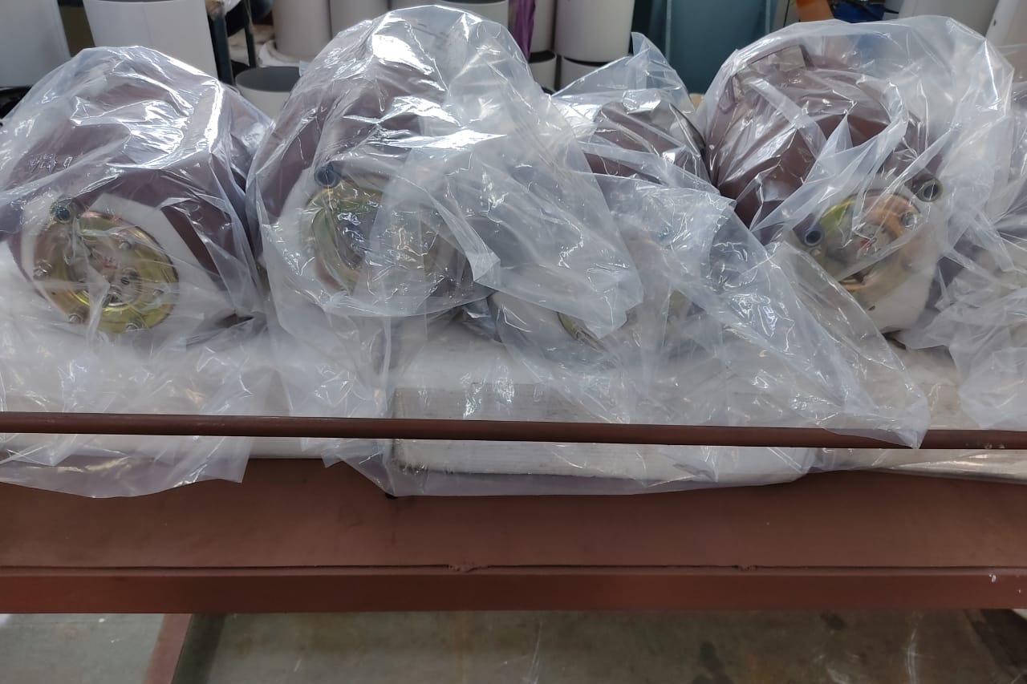
Kaizen
Dept./Section : Storage water heater
Process : Geyser Assembly Line
Date of implementation : 08-02-2021
Improvement categories (Tick the applicable one’s) :
(1) Quality imp.
(2) Manpower/Man hours
(3) Reduce 3M
(4) Space saving
(5) Time saving
(6) Energy Saving
(7) Tact
(8) Yield
(9) 5S
(10) Efficiency
(11) Material Saving
(12) Waste Reduction
(13) Packing
(14) Safety
(15) Others
Before
After
Assembled Tank on floor.
Properly arranged with table
Benefits:
1- Very less chances of coating breakage
2- Floor Cleaning
3- Effective space utilization

